Slide 1
DISTANCE-TIME GRAPHS

Slide 2
Distance-Time Graph
Graph that represents the time it takes an object to go a specific distance (speed).
Time is ALWAYS on the x-axis
Distance is ALWAYS on the y-axis
ZERO speed will be indicated with a horizontal line on a distance time graph.
Constant Speed is indicated when the line stays straight.
Distance travelled is indicated when the line slants up/down.

Slide 3
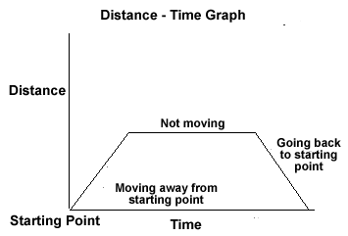

Slide 4
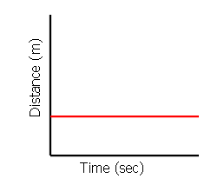
Interpret The Graph Below:

Slide 5
Interpret The Graph Below:
The graph shows an object which is not moving (at rest).
Speed=0
The distance stays the same as time goes by because it is not moving.

Slide 6
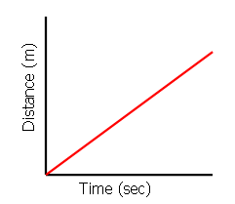
Interpret The Graph Below:

Slide 7
Interpret The Graph Below:
The graph shows that the objects distance increases as time passes. The object is moving and so it has velocity.
The straight line shows it is a constant (not changing).

Slide 8
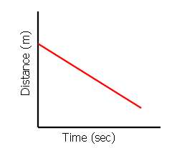
Interpret The Graph Below:

Slide 9
Interpret The Graph Below:
Just like the previous graph, this graph shows an object moving with constant velocity

