Slide 1
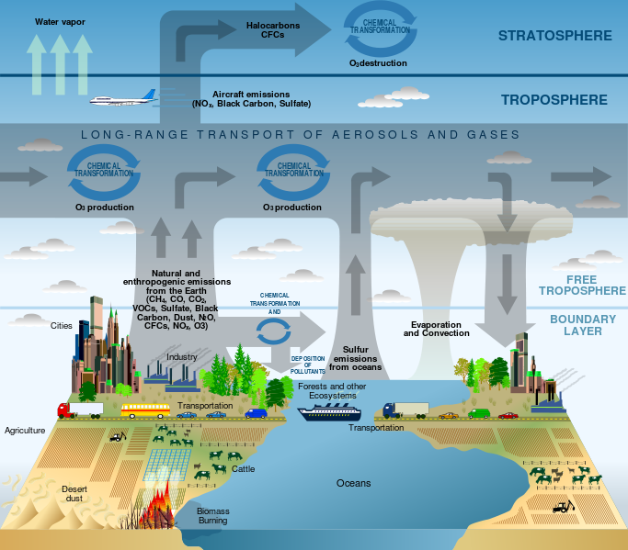
Earth’s Atmosphere Notes

Slide 2
Agree or Disagree
Earth’s atmosphere is mostly oxygen. Agree/Disagree
Air is weightless. Agree/Disagree
Without the atmosphere, we would burn up.
Agree/Disagree
We live in the warmest part of the atmosphere.
Agree/Disagree
Our atmosphere is over 100 miles thick. Agree/Disagree

Slide 3
Agree/Disagree
Earth’s atmosphere is mostly oxygen. Agree/Disagree
Air is weightless. Agree/Disagree
Without the atmosphere, we would burn up. Agree/Disagree
We live in the warmest part of the atmosphere. Agree/Disagree
Our atmosphere is over 100 miles thick. Agree/Disagree

Slide 4
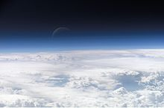
Atmosphere
A layer of gases surrounding the planet Earth
2 Ways It Makes Life Possible
Absorbs UV radiation
Warms the surface through heat retention

Slide 5
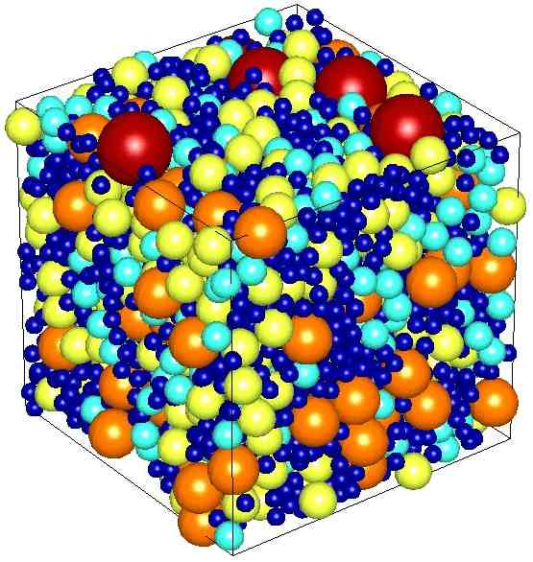
Characteristics
Altitude
The height of an object or point in relation to sea level or ground level.
Density
Refers to how closely "packed" or "crowded" the air molecules appear to be
As Altitude Increases
Density Decreases

Slide 6
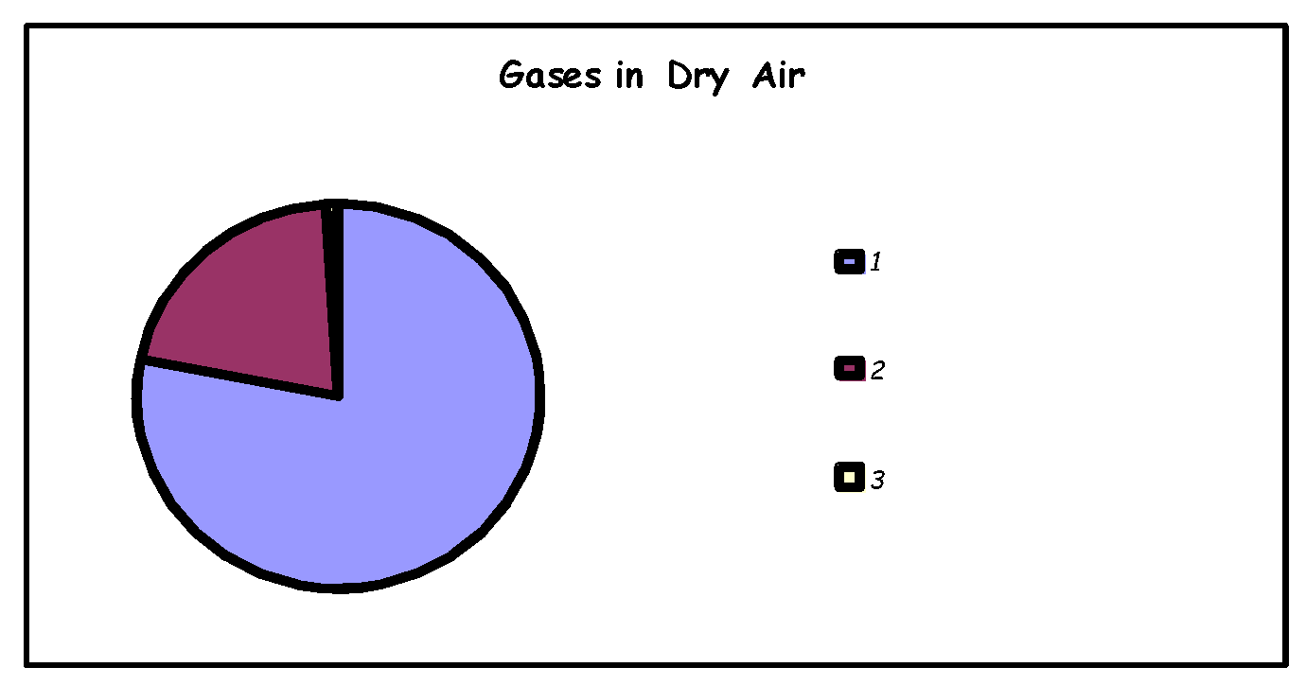
Materials
Gases
Oxygen (21%)
Nitrogen (78%)
Trace Gases (1%) – CO2, He, H
Particles
Dust
Smoke
Pollen
Label the Chart:
Nitrogen
Oxygen
Trace

Slide 7
Gases
Nitrogen:Plants require adequate supply of nitrogen for their proper growth and development.
Oxygen:Supports life and metabolic processes
Carbon Dioxide:Plants need it for photosynthesis, emitted from animals during respiration, warms the atmosphere by absorbing infrared radiation
Water Vapor:Precipitation, weather, warms the atmosphere by absorbing infrared radiation

Slide 8
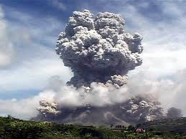
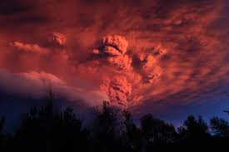
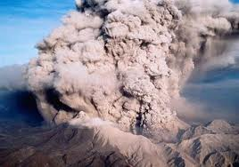
Sudden Changes
Volcanic Eruptions
Ash flies out of the top of it and then the air is filled with a thick smoke. The ash then spread outs, and forms an ash cloud. It contains greenhouse gases such as methane and carbon dioxide, which contributes to global warming. It may result in acid when rain falls from the ash clouds. It may also block out vision after ashes haze the air.
If the resulting ash cloud is large enough, the eruption can cause a short-term cooling by blocking sunlight as it spreads throughout much of the world.

Slide 9
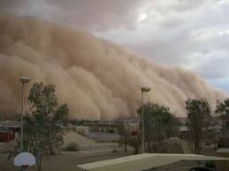
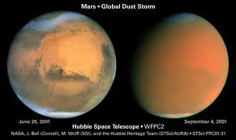
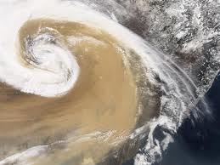
Sudden Changes
Dust Storms
Dust particles have a radioactive effect on climate through reflection and absorption of solar radiation. It can lead to severe cooling days or hot days depending on dust particles’ properties and in what part of the atmosphere they are found.

Slide 10
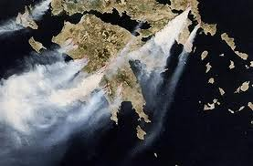
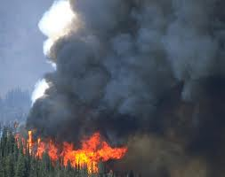
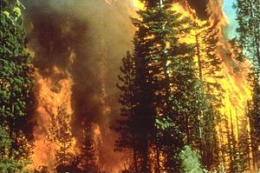
Sudden Changes
Forest Fires
Wildfires can affect climate and weather and have major impacts on atmospheric pollution. Wildfire emissions contain fine particulate matter which can cause cardiovascular and respiratory problems.

Slide 11
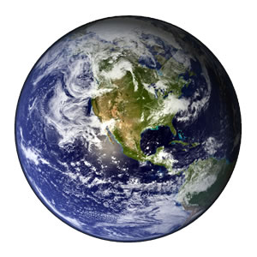
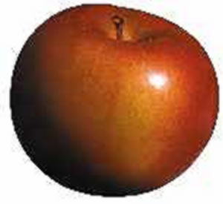
Apple DEMO
This image, dubbed by NASA as the “blue marble,” is the most detailed true-color image of the entire Earth to date.
Below it we see an ordinary apple
(small).
The diameter of the earth at the equator is 7,926.41 miles (12,756.32 kilometers)
Suppose the Earth were the size of an apple, about 3 inches across. If Earth were the size of an apple, the atmosphere would be no thicker than the apple skin!

Slide 12
Apple DEMO
Hypothesis:
If we peel the apple and let it sit for a couple days,
then the mass of the apple will ____________.
Procedure:
Weigh an apple on the scale and record its mass below.
Peel the apple and weigh its mass below.
Wait two days while the apple sits in the room
and then record its mass below.
Data
Mass of Apple _____
Mass of Peeled Apple _____
Mass of Peeled Apple after 2 days _____

Slide 13
Apple DEMO
Analysis:
Subtract the mass of the peeled apple from the 2 day old apple to find the change in mass of the apple.
Change in Mass of Apple _____
Conclusion:
Write a two sentence summary about your results.
Was your hypothesis correct?
How do you think the apple compares to our atmosphere?

