Slide 1
Humidity

Slide 2
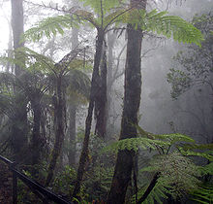
Humidity
We already know that evaporation allows water to change into a gas and rise into our atmosphere. Eventually, it will condense into clouds when cooler temperatures are near. Well, what happens if the water vapor stays close to the ground where we are?
We use the term humidity to describe the amount of evaporated water or water vapor in the air.

Slide 3
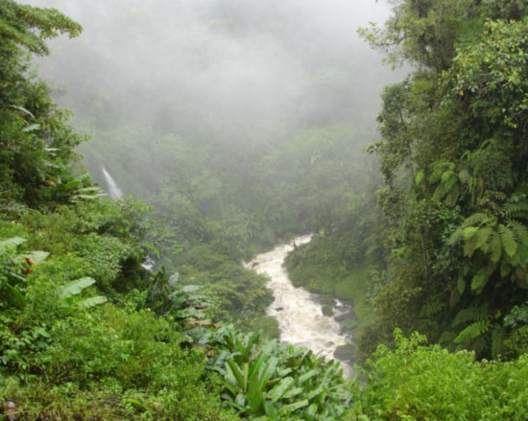
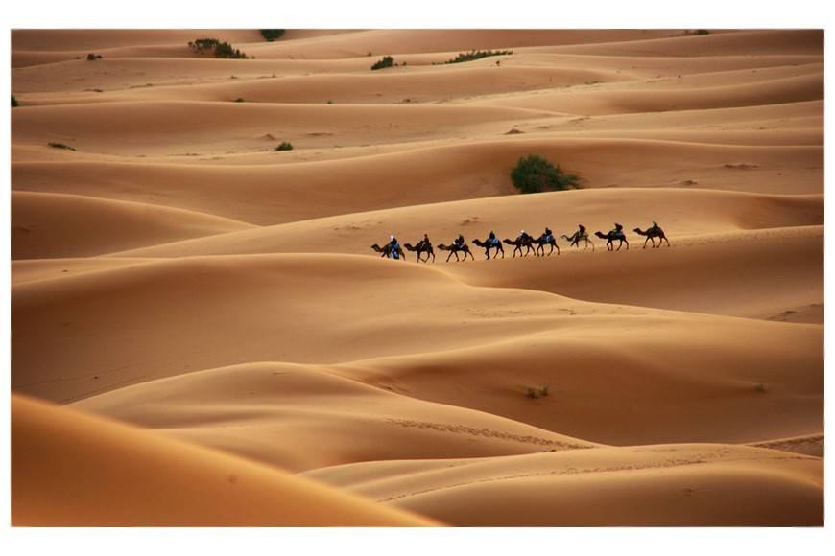
Humidity
Humidity can vary from place to place. The amount of water vapor that air can hold depends on temperature. The warmer the air, the more water vapor it can hold. Think about it, warm air is less dense so it has more room for water vapor.
High Humidity Low Humidity

Slide 4
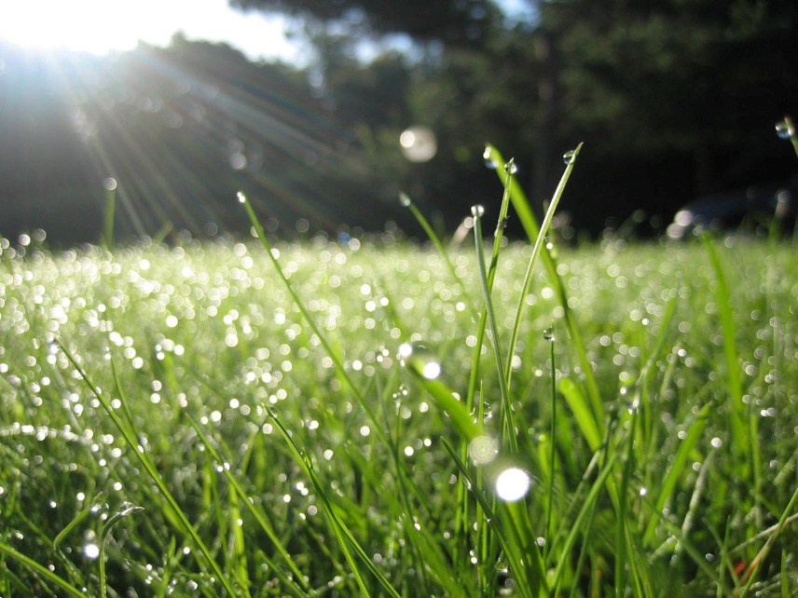
Saturation
When the air is holding as much water vapor as possible at a certain temperature it has reached saturation. Think about a sponge, at some point it can no longer hold any more water. Well, the air has its limits too and the deciding factor is the temperature. The temperature at which this saturated air starts to condense onto surfaces or into precipitation is called the dew point.

Slide 5
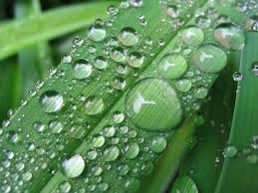
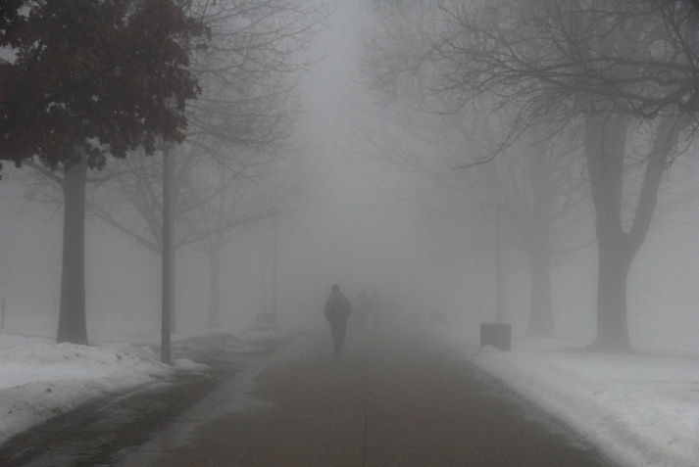
Dew and Fog
Early in the morning, the air temperature usually cools, which allows water to condense. When this cooling and condensing causes water to form on grass and other surfaces, we call it ________. If there is enough water vapor that condenses you can get clouds close to the ground which are called __________.
Dew Fog

Slide 6
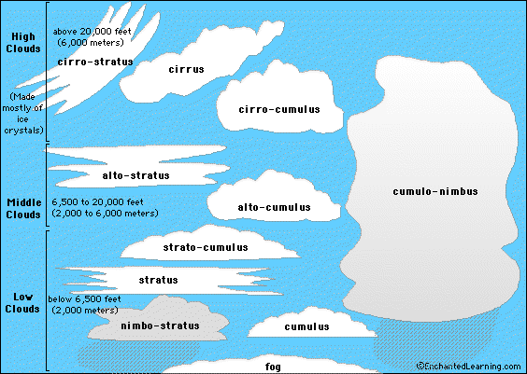
Clouds
Similar to dew forming on grass, water vapor must have something to condense on to form clouds in the upper layers of the troposphere. As water vapor rises into cooler air, it condenses on dust and other particles. The water drops and ice crystals are so light, they stay afloat and collect more water forming clouds. The droplets/crystals continue to stay aloft until they become too heavy and fall as precipitation.

Slide 7
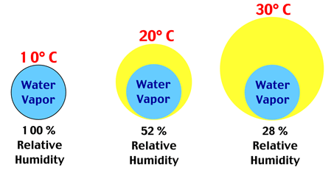
Relative humidity measures how much water vapor is actually there compared to how much water vapor air can actually hold. Think about your grade on a test. Your grade is a comparison of how many you got right to how much you could have earned. So, an 86% means you got 86 out of 100 possible points. Relative humidity is similar. 86% relative humidity means the air is holding 86% of the water it could hold at that particular temperature. The warmer the air, the more water vapor it can hold.

