Slide 1
Respiratory System

Slide 2
Define the following words.
Respiratory System: A system that interacts with the environment and with other body systems to bring oxygen to the body and remove carbon dioxide.
Cellular Respiration: a process in which cells use oxygen to release energy stored in sugars
Homeostasis: a condition needed for health and functioning in which an organism or cell maintains a relatively stable internal environment.

Slide 3
Your body needs oxygen
You breathe thousands of times a day
Breathing is a sign of life
Body is unable to store very much oxygen
The respiratory system uses both mechanical movement and chemical reactions.
Air is transported into the lungs with mechanical movement
Oxygen is used during chemical reactions that releases energy to cells.

Slide 4
The human body needs oxygen to survive!!!
Without oxygen, cells die very quickly!

Slide 5
Respiratory System Main Functions
Get oxygen from environment!
Remove carbon dioxide and other wastes from body!

Slide 6
Exchanging O₂ and CO₂
When we inhale a bunch of different gases together.
20% = oxygen
<1% = carbon dioxide
~80%= nitrogen
Air that is exhaled contains a larger amount of carbon dioxide.
It is important to exhale CO2 because high levels of CO2 can damage and/or destroy cells
Once breathed in, Red blood cells bring oxygen to all parts of the body.

Slide 7
Cellular Respiration
Happens inside your cells
Chemical reaction where oxygen is turned into energy
CR requires glucose (you get from food) and oxygen
Glucose = sugar
Carbon dioxide is the waste product of cellular respiration and must be removed

Slide 8
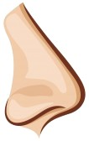
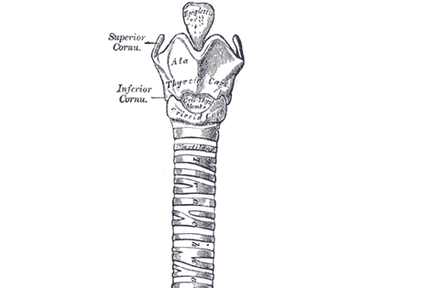
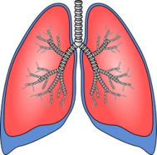
Path air travels…
Nose/Mouth
Both filter out unwanted particles and dirt in air
Nasal cavity warms air slightly
Trachea (aka windpipe)
Epiglottis keeps air from entering your stomach and food from entering your lungs
Lungs
Two large organs, located on either side of your heart

Slide 9
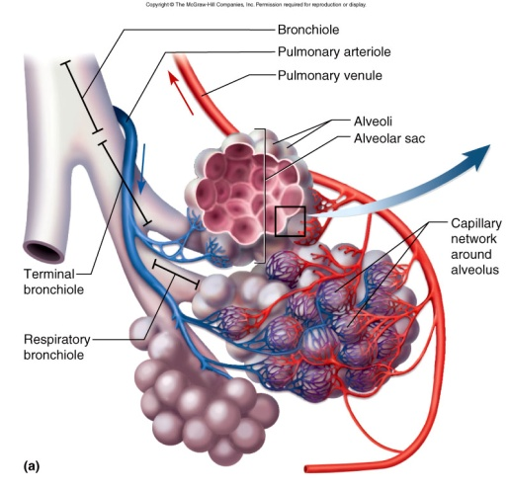
Path air travels…
Bronchial Tubes
Connects trachea and lungs
Branch out throughout lungs into smaller and smaller tubes
Alveoli
Located at the end of each branch of the bronchial tubes
Oxygen passes through the walls of the alveoli and diffused into the blood.
At the same time carbon dioxide is passed from the blood into the alveoli.

Slide 10
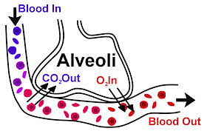

Slide 11
Ribs and Diaphragm
Rib cage encloses a space inside your body called the thoracic cavity
Rib cage is flexible because some ribs are connected with cartilage
Diaphragm stretches across the floor of the thoracic cavity.
Inhale – diaphragm contracts and pulls downward, expanding the thoracic cavity --- pulling air into the lungs
Exhale --- exact opposite

